Slide 1


John Kopp
April, 25 2025

Slide 2

Outline
Executive Summary
Introduction
Methodology
Results
Conclusion
Appendix

Slide 3
Executive Summary
Overview
SpaceX advertises its successful Falcon 9 launches are 62 million dollars while its competitors cost upward of 165 million dollars for the same service. SpaceX is able to offer these savings because it successfully can land and reuse the first stage of the Falcon 9 booster rocket from many of its launches.
Data collection was performed on SpaceX historical and launch data to determine whether retrieval of the first stage booster rocket can be predicted with a model built with supervised learning.
Technical launch data was retrieved from SpaceX APIs and Historical launch data was scraped from a Wikipedia website.

Slide 4
Executive Summary
Methods and Results, Page 1
Exploratory Data Analysis was performed using both descriptive statistics and visualizations. Relationship between variables and successful outcomes were noted.
Payload vs Launch Site visualization showed that higher success rates were associated with heavier payloads. Additionally, the Vanderburg Space Force Base only had launches with payload under 10000 kg.
Certain orbit types were found to be correlated with successful missions. ES-L1, GEO, HEO and SSO has 100% success rates.
Flight number with success/failure status was plotted against orbit type. It was seen seen that for VLEO the rate of success seems dependent on flight number. The relationship between success and flight number for other orbit types such as GTO and VLEO is less clear.
Success as a function of Payload vs Orbit type was visualized. Successful landing for heavy payloads are more likely for Polar, LEO and ISS. For GTO, a correlation between payload and success cannot be seem as the data is mixed.
The success rate was seen to generally increase with year. Rates kept rising from 2013 to 2017. Slight dips are seen in 2018 and 2020, but the overall increasing rate is clear.

Slide 5
Executive Summary
Methods and Results, Page 2
SQL Analysis was performed on the data set with some interesting results.
Total payloads brought to space by SpaceX during the period were 45596 kg.
The average payload for the F9 V1.1 booster was 2535 kg.
Successful drone ship landings were seen with 4 different F9 booster versions.
A total of 98 missions were con2010-06-04 and 2017-03-20ducted over the period.
It is seen that between 2010 and 2017 the successful landings are in the minority. The most common outcome was no attempt at landing.

Slide 6
Executive Summary
Methods and Results, Page 3
Launch site locations and proximities to nearby highways, railways and coasts were studied and visualized using Folium.
The location of the launch sites and launch outcomes were plotted on a map of the United States to foster better understanding.
Proximity analysis was conducted. It was found that the launch sites were close to highways, railways and the coast.
Close railways and highways support transport of needed resources.
Close oceans are needed to support ocean landings as are sometimes conducted.

Slide 7
Executive Summary
Methods and Results, Page 4
Interactive dashboards of launch outcomes and payload vs outcome were built using Plotly and Dash.
It was seen that the most successful launches occurred at KSC LC-39A site.
The CCAFS SLC-40 site was found to have the highest success ratio with 42.9% successful launches.
Analysis of payload vs success for various booster models showed the FT booster version has the best success across payloads from 2000 kg to 5500 kg. The v1.1 and B5 boosters have poor success and the B4 booster has mixed success across this payload range.

Slide 8
Executive Summary
Methods and Results, Page 5
Predictive analysis was performed and 4 classification models were built and evaluated
Four models, Logistic Regression, SMV, Binary Tree and KNN were developed.
A grid search method was used to find optimal hyperparameters for each.
The accuracies of each of the models were found to be equivalent and equal to 0.833.
The confusion matrix of each model was graphed. As with accuracy, the confusion matrix for each model was found to be identical. The models predicted landed missions perfectly with 12 true positives and no false positives. Performances on unsuccessful missions was poor with 3 true negatives and 3 false negatives.
The equal performance of all the models was probably due to the small size of the data set.

Slide 9
Introduction
Project background and context
SpaceX advertises its successful Falcon 9 launches are 62 million dollars while its competitors cost upward of 165 million dollars for the same service. SpaceX is able to offer these savings because it successfully can land and reuse the first stage of the Falcon 9 booster rocket from many of its launches.
Question to be answered
Successful launches depend on many factors and sources of data. Data was collected from both SpaceX via API and from summary data on Wikipedia to perform data analysis and modeling. This study determines which factors influence successful retrieval of the first stage of the rocket and forms a prediction model to predict successful retrievals. With this information, competitors to SpaceX could offer similar services.

Slide 10

Section 1

Slide 11
Methodology
Executive Summary
Data collection methodology:
Describe how data was collected
Perform data wrangling
Describe how data was processed
Perform exploratory data analysis (EDA) using visualization and SQL
Perform interactive visual analytics using Folium and Plotly Dash
Perform predictive analysis using classification models
How to build, tune, evaluate classification models

Slide 12
Data Collection
Overview
The data that drove analysis and modeling was collected from two main sources.
SpaceX APIs were utilized to retrieve key technical details about each launch. These APIs provided technical details about each launch such as booster version, payload mass, launch pad, type of landing. Data from several APIs were combined to form a dataset.
Historical records were scraped from a Wikipedia page, "List of Falcon 9 and Falcon Heavy Launches". This historical data has information about the launch date, launch site, booster details, landings and success or failure of the mission and landing.

Slide 13
Data Collection – SpaceX API
Data was collected from SpaceX APIs. Data from several API calls was combined to form a data set that included BoosterVersion, PayloadMass, Orbit, LaunchSite, Outcome, Flights, GridFins, Reused, Legs, LandingPad, Block, ReusedCount, Serial, Longitude, Latitude. Data was obtained using a HTTP get request, converted to JSON and loaded in Pandas dataframes.
The Jupyter Notebook containing details of the processing of SpaceX API calls is located at data-science-capstone/jupyter-labs-spacex-data-collection-api-v2.ipynb at master · jrkopp/data-science-capstone
Call SpaceX launches/past API and Store in Dataframe
Call Additional APIs to Replace IDs with Actual Information
Get Booster Data
Get Launch Site Data
Get Payload Data
Get Core Data
Load into dictionary, then convert to data frame
Filter to Falcon Data
Data Wrangling – Replace missing payload with mean payload.

Slide 14
Data Collection - Scraping
Historical launch data was scraped from the Wikipedia page, "List of Falcon 9 and Falcon Heavy Launches". Data was pulled via HTTP GET request, parsed with BeautifulSoup and loaded into a dataframe. Data included date, flight no, launch site, payload, orbit, customer, launch outcome, booster version and outcome.
The Jupyter notebook containing details on the web scraping is located at data-science-capstone/jupyter-labs-webscraping.ipynb at master · jrkopp/data-science-capstone
Request Falcon9 Launch Page via HTTP request
Parse the response using BeautifulSoup to find the Launch Table.
Determine the column names from the launch table
Create a dictionary with keys equal to the column headers and values of empty arrays to store data
Iterate through the table from the webpage and store in the dictionary
Load into a Pandas dataframe and save for further analysis

Slide 15
Data Wrangling
The starting point for the data wrangling effort was a pandas dataframe containing data from SpaceX APIs that was stored within a CSV file. The goal of this exercise was to determine labels (targets) for each launch that could be used for training supervised models. Each record in the dataset contained an outcome that depended on both where the booster landing site was (ocean, drone ship, land) and the outcome. These were mapped into binary labels which indicate success or failure. Preliminary exploratory data analytics was also performed on the data to understand its fit to answering the business question of predicting successful retrievals of the first stage booster.
Full details of the data wrangling are given in the Jupyter Notebook stored at this link. data-science-capstone/labs-jupyter-spacex-Data wrangling-v2.ipynb at master · jrkopp/data-science-capstone
See next page for visualizations.

Slide 16
Data Wrangling, Continued
Load dataframe containing SpaceX Launch Data from CSV file
Perform Exploratory Data Analysis
Look for null values and determine the data type of each field
Nulls found only in Launch Site column
Launch Site Count
CCAFS SLC 40 55
KSC LC 39A 22
VAFB SLC 4E 13
Orbit Type Count
GTO 27
ISS 21
VLEO 14
PO 9
LEO 7
SSO 5
MEO 3
HEO 1
ES-L1 1
SO 1
GEO 1
Determine the number of launches at each site
Determine the number and occurrences of each orbit
Outcome Count
True ASDS 41
None None 19
True RTLS 14
False ASDS 6
True Ocean 5
False Ocean 2
None ASDS 2
False RTLS 1
Determine the number and occurrences of mission outcomes
Create a landing outcome label from the mission outcomes
Mean Outcome: 0.667
Success: 60
Failure: 30
Total Missions: 90

Slide 17
EDA with Data Visualization
Exploratory data analysis was conducted on the SpaceX Launch Data. Visualizations were used to understand the relationships and correlations between variables. Feature Engineering was done to one-hot encode categorical variables into numeric for use in modeling.
The following variables were one-hot encoded to create numeric values for later modeling: Orbits, LaunchSite, LandingPad, Serial.
Full details on the data visualization and feature engineering can be found at this link: data-science-capstone/jupyter-labs-eda-dataviz-v2.ipynb at master · jrkopp/data-science-capstone
Visualization | Plot Type
Launch Site vs Flight Number | Scatter (with hue)
Launch Site vs Payload | Scatter (with hue)
Success Rate vs Orbit | Bar
Orbit vs Flight Number | Scatter (with hue)
Payload vs Orbit | Scatter (with hue)
Launch Success vs Year | Line

Slide 18
EDA with SQL
SQL analysis and queries were performed on the SpaceX dataset to further understand the data. The following queries were performed.
Display the names of the unique launch sites in the space mission
Display five records where launch sites begin with the string "CCA"
Display the total payload mass carried by boosters launched by NASA (CRS)
Display average payload mass carried by booster version F9 v1.1
List the data when the first successful landing outcome in ground was achieved
List the names of the boosters which have success in drone ship and have payload mass greater than 4000 but less than 6000
List the total number of successful and failure mission outcomes
List all the booster versions that have carried the maximum payload mass. Use a subquery.
List the records which will display the month names, failure landing outcomes in drone ship ,booster versions, launch site for the months in year 2015.
Rank the count of landing outcomes (such as Failure (drone ship) or Success (ground pad)) between the date 2010-06-04 and 2017-03-20, in descending order.
Full details on the SQL analysis and queries can be found at this link: data-science-capstone/jupyter-labs-eda-sql-coursera_sqllite.ipynb at master · jrkopp/data-science-capstone

Slide 19
Build an Interactive Map with Folium
The launch success rate of SpaceX missions is dependent on technical factors, but also on the location of the launch. The location and proximities of the launch determines the trajectory the rocket must take and also determines the how/where the booster may land. To analyze these geographical properties the Folium python library for maps was used. Key useful features of Folium are:
A map was plotted focused on the continental United States.
Folium circles and markers were added to the map to allow easy identification of the launch sites. This allowed the sites to be easily identified on the map and allowed visual inspection and understanding of where the locations of the sites and their closeness to the coast and cities. Distance to the equator could be estimated.
Marker clusters, with markers of green for success and red for failure, were added to each launch site on the map. This allows to simply identify the relative success rates of each site.
Mouse Position and Markers was used to mark and label geographically significant locations on the map such as the nearest ocean and the nearest city, highway, rails to each launch site. A distance function was built and used to measure the distance between these landmarks and the launch site. Distance lines were drawn between these locations using Polyline.
Launch site proximities for the coast, highways, railways and cities were considered.
Full details showing the maps and analysis can be found in the Jupyter Notebook at this link: data-science-capstone/lab-jupyter-launch-site-location-v2.ipynb at master · jrkopp/data-science-capstone

Slide 20
Build a Dashboard with Plotly Dash
A dashboard to interactively analyze and understand the launch data was built using Plotly and Dash. The dashboard contained both controls and graphs.
A dropdown was added to allow selection of the launch site either All, CCAFS LC-40, VAFB SLC-4E, KSC LC-39A, CCAFS SLC-40. This selection was used to drive the display on each graph.
A pie chart was added. Based on the location selected in the dropdown it displayed either total success/failure or success/failure at a given launch site.
A slider was added to allow examination of the impact of different payload masses. It, along with the launch location, were used to allow interactive analysis of the relationship between payload and success.
A scatter plot was added to allow analysis of the correlation between payload and launch success.
Full details on the dashboard can be found in the python script located at: data-science-capstone/spacex_dash_app.py at master · jrkopp/data-science-capstone

Slide 21
Predictive Analysis (Classification)
Exploratory data analysis was performed and training labels were assigned to the SpaceX data set. Data was standardized to remove the effects of features having different scales. The dataset and training labels were split into training and test data using train_test_split.
Supervised machine learning was used to build SVM, Decision Tree, KNN Classification Trees and Logistic Regression models.
Grid Searches were performed to find the best hyperparameters for each model using the training data.
The test data was used to evaluate model performance. Both accuracy and confusion models were used to determine the model that best predicted launch outcome. The confusion matrices were plotted and reviewed.
A flow chart of the process is presented on the next page.
Full details of the exploratory data analysis, standardization, model development and evaluation can be found in the Jupyter notebook at this link: data-science-capstone/SpaceX-Machine-Learning-Prediction-Part-5-v1.ipynb at master · jrkopp/data-science-capstone

Slide 22
Predictive Analysis (Classification) (Continued)
Load the SpaceX Dataset / Create a Label Vector from the Class column to hold actual outcomes
Standardize the data set so that each feature has zero mean and unit variance
Split the data into training and test sets
Logical regression model
Decision Tree model
K Nearest Neighbors model
SVM model
Grid Search to Optimize Hyperparamters
Grid Search to Optimize Hyperparamters
Grid Search to Optimize Hyperparamters
Grid Search to Optimize Hyperparamters
Review accuracy and Confusion Matrix
Review accuracy and Confusion Matrix
Review accuracy and Confusion Matrix
Review accuracy and Confusion Matrix
Compare Results and Determine Best Performing Model

Slide 23
Results
Exploratory data analysis results
Interactive analytics demo in screenshots
Predictive analysis results

Slide 24

Section 2

Slide 25
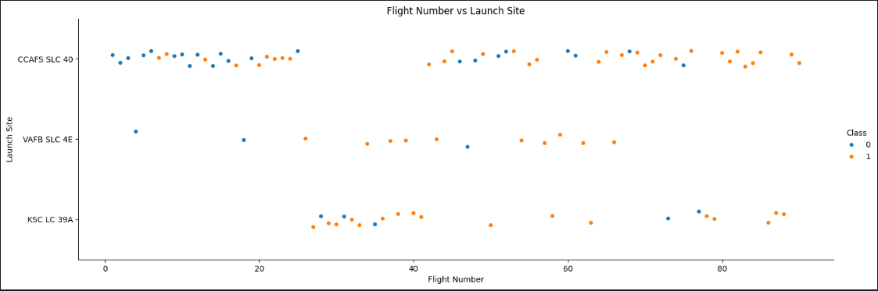
Flight Number vs. Launch Site
This scatter plot shows Launch Site vs Flight Number along with the success or failure of each plot. It is seen that more recent flights (higher flight number) have more successes. The CCAFS SLC 40 launch site was used for many early launches and the VAFB SLC 4E site hasn't been used recently. Most recent launches are at KSC LC 39A and CCAFS SLC 40.

Slide 26
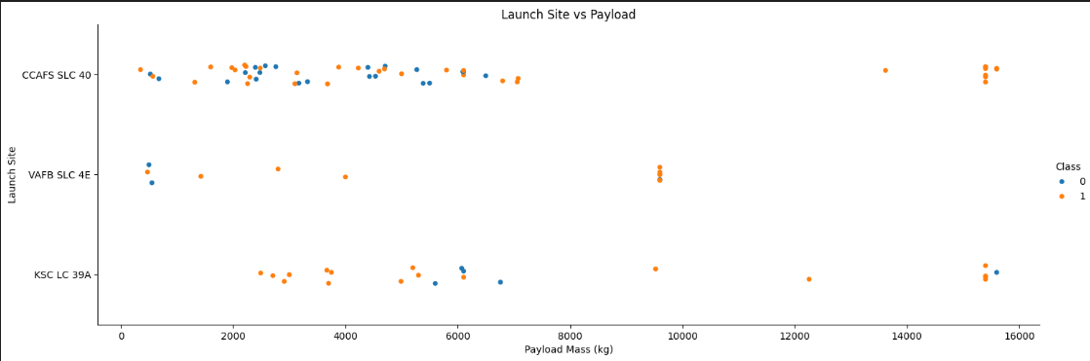
Payload vs. Launch Site
This scatter plot shows launch site with success or failure against payload mass (kg). The Vanderburg Space Force Base has no launches with payload greater than 10000 kg.

Slide 27
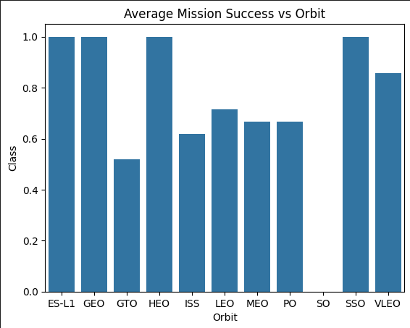
Success Rate vs. Orbit Type
This bar chart shows average mission success vs Orbit. It is seen that success varies based on orbit type. ES-L1, GEO, HEO and SSO are seen to have perfect success rates (class = 1).

Slide 28
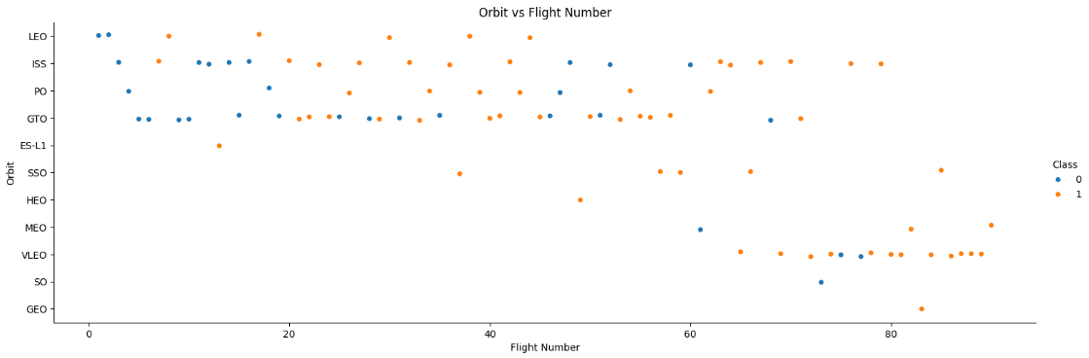
Flight Number vs. Orbit Type
This scatter plot shows the relationship between orbit (with success/failure) vs flight number. It is seen that for VLEO the rate of success seems dependent on flight number. The relationship between success and flight number for other orbit types such as GTO and VLEO is less clear.

Slide 29
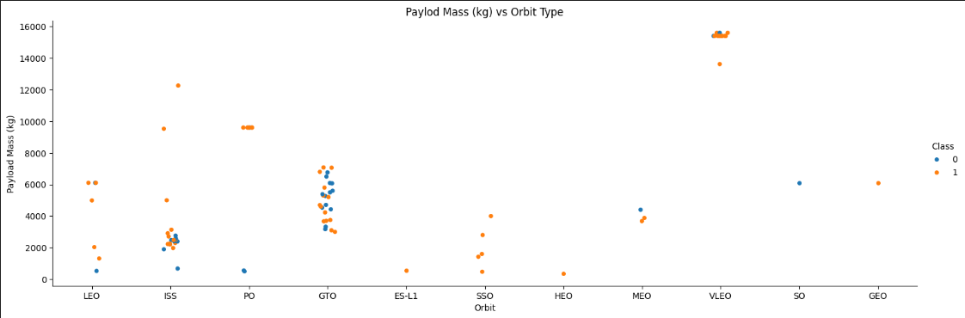
Payload vs. Orbit Type
Successful landing for heavy payloads are more likely for Polar, LEO and ISS. For GTO, a correlation between payload and success cannot be seem as the data is mixed.

Slide 30
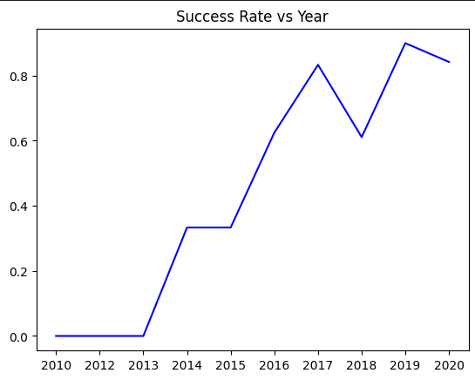
Launch Success Yearly Trend
This line plot shows success rate vs year. It is seen that there is a positive correlation with success generally increasing with year. Rates kept rising from 2013 to 2017. Slight dips are seen in 2018 and 2020, but the overall increasing rate is clear.

Slide 31
All Launch Site Names
SpaceX has used 4 unique launch sites.
The following query was run against the SpaceX dataset loaded into a sqlite database. The distinct keyword was used to eliminate duplicate rows from the query result set.
SELECT DISTINCT Launch_Site
FROM SPACEXTABLE
Launch_Site
CCAFS LC-40
VAFB SLC-4E
KSC LC-39A
CCAFS SLC-40

Slide 32
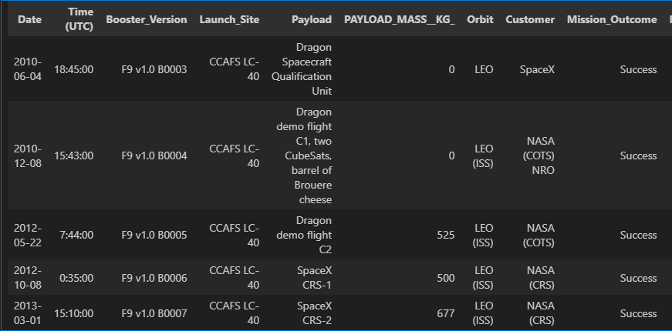
Launch Site Names Begin with 'CCA'
The SpaceX dataset was loaded into a SQLite database and the following query was run. Limit was used to get only the first 5 rows shown below. All columns are not shown in order to fit on the slide.
SELECT *
FROM SPACEXTABLE
WHERE Launch_Site
LIKE "CCA%"
LIMIT 5;

Slide 33
Total Payload Mass
The SpaceX dataset was loaded into a SQLite database and the following query was run to determine the total payload mass carried by boosters launched by NASA (CRS). The query run and results are given below.
SELECT SUM(PAYLOAD_MASS__KG_)
FROM SPACEXTABLE
WHERE Customer = "NASA (CRS)";
Total Payload Mass = 45596 kg
The query is seem to use the aggregate sum function with a where clause limiting the customer to NASA (CRS)

Slide 34
Average Payload Mass by F9 v1.1
The SpaceX dataset was loaded into a SQLite database and the following query was run to determine the average payload mass carried by the booster version F9 v1.1. The query run and results are given below.
SELECT AVG(PAYLOAD_MASS__KG_)
FROM SPACEXTABLE
WHERE Booster_Version
LIKE "F9 V1.1%";
The average payload mass in kilograms was found to be 2534.67 kg. This is relatively low given the range of payloads up to 16000kg showing that many payloads were small. The aggregate function average was used in the query with the results limited to booster version like "F9 v1.1".

Slide 35
First Successful Ground Landing Date
The SpaceX dataset was loaded into a SQLite database and the following query was run to determine the first successful landing outcome on ground. The query run and results are given below.
SELECT MIN(Date)
FROM SPACEXTABLE
WHERE Landing_Outcome = "Success (ground pad)";
The minimum date was found to be 2015-12-22.
The SQL min function was used to find the minimum from the rows where outcome as "Success (ground pad)".

Slide 36
Successful Drone Ship Landing with Payload between 4000 and 6000 Kg
The SpaceX dataset was loaded into a SQLite database and the following query was run to determine the names of the boosters with successful drone ship landings and payloads between 4000 and 6000 kg. The query run and results are given below.
SELECT DISTINCT Booster_Version
FROM SPACEXTABLE
WHERE Landing_Outcome = "Success (drone ship)"
AND PAYLOAD_MASS__KG_ > 4000
AND PAYLOAD_MASS__KG_ < 6000;
Results:
Booster_Version
F9 FT B1022
F9 FT B1026
F9 FT B1021.2
F9 FT B1031.2
A distinct was used in the query to remove duplicate results. The where clause limited results to those with successful drone ship landing and payloads between 4000 and 6000 kg.

Slide 37
Total Number of Successful and Failure Mission Outcomes
The SpaceX dataset was loaded into a SQLite database and the following query was run to calculate the total number of successful and failure mission outcomes. The query run and results are given below.
SELECT COUNT(*)
FROM SPACEXTABLE;
WHERE Mission_Outcome
IN ('Success','Failure');
A total of 98 missions were found.
The count function was used to determine the number of rows with success or failure. This number is actually the total number of rows since the only outcomes were success or failure. The outcome criteria was included in the query in case some rows had other outcomes.

Slide 38
Boosters Carried Maximum Payload
The SpaceX dataset was loaded into a SQLite database and the following query was run to list the names of the boosters which have carried the maximum payload mass. The query run and results are given below.
QUERY RESULTS DISCUSSION
SELECT Booster_Version
FROM SPACEXTABLE
WHERE PAYLOAD_MASS__KG_ =
(SELECT MAX(PAYLOAD_MASS__KG_)
FROM SPACEXTABLE);
Booster_Version
F9 B5 B1048.4
F9 B5 B1049.4
F9 B5 B1051.3
F9 B5 B1056.4
F9 B5 B1048.5
F9 B5 B1051.4
F9 B5 B1049.5
F9 B5 B1060.2
F9 B5 B1058.3
F9 B5 B1051.6
F9 B5 B1060.3
F9 B5 B1049.7
It is seen that there are multiple versions of the F9 booster that carried the maximum payload. The query uses a subquery to first find the maximum payload and then finds all boosters that have carried that payload.

Slide 39
2015 Launch Records
The SpaceX dataset was loaded into a SQLite database and the following query was run to list the failed landing outcomes on drone ships, their booster versions, and launch site names for the year 2015. The query run and results are given below.
SELECT SUBSTR(Date,6,2), Landing_Outcome, Booster_Version, Launch_Site
FROM SPACEXTABLE
WHERE SUBSTR(Date,0,5) = '2015'
AND Landing_Outcome = 'Failure (drone ship)';
Because SQLite does not support month names, substrings were used to get the month and the year as well. It is seem that there were two failed landings on drone ships in 2015.
SUBSTR(Date,6,2) | Landing_Outcome | Booster_Version | Launch_Site
01 | Failure (drone ship) | F9 v1.1 B1012 | CCAFS LC-40
04 | Failure (drone ship) | F9 v1.1 B1015 | CCAFS LC-40

Slide 40
Rank Landing Outcomes Between 2010-06-04 and 2017-03-20
The SpaceX dataset was loaded into a SQLite database and the following query was run to rank the count of landing outcomes (such as Failure (drone ship) or Success (ground pad)) between the date 2010-06-04 and 2017-03-20, in descending order. The query run and results are given below.
SELECT COUNT(Landing_Outcome), Landing_Outcome
FROM SPACEXTABLE
WHERE Date BETWEEN '2010-06-04' AND '2017-03-20'
GROUP BY Landing_Outcome
ORDER BY COUNT(Landing_Outcome) DESC;
COUNT | Landing_Outcome
10 | No attempt
5 | Success (drone ship)
5 | Failure (drone ship)
3 | Success (ground pad)
3 | Controlled (ocean)
2 | Uncontrolled (ocean)
2 | Failure (parachute)
1 | Precluded (drone ship)
It is seen that between 2010 and 2017 the successful landings are in the minority. The most common outcome was no attempt at landing. Ranking in the query was achieved by an order by. Outcomes were grouped and counted

Slide 41

Section 3

Slide 42
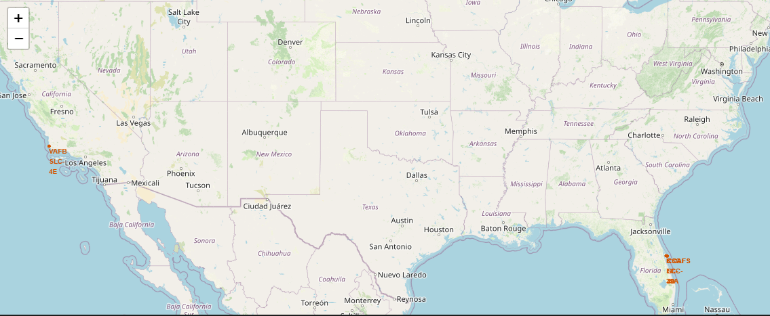
Map of All SpaceX Launch Sites in the United States
This folium map displays the launch sites on a map of the United States. The location of each launch site is surrounded by a red cirle and each site is labelled by a marker with the site name.

Slide 43
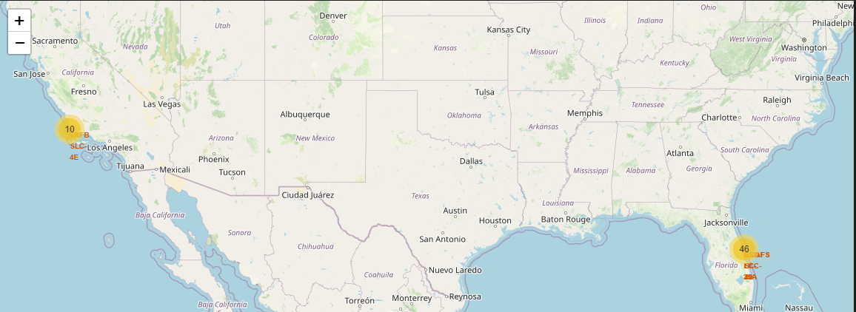
Success and Failed Launces for Each Launch Site (Page 1)
See analysis on next page.

Slide 44
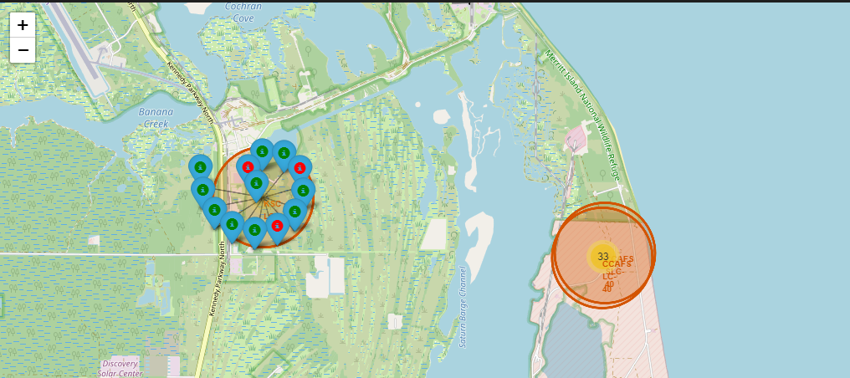
Success and Failed Launces for Each Launch Site (Page 2)
A marker cluster was used for each launch site. The location of each launch can be seen by drilling in with the success or failure indicated by the color of the marker, red or green.

Slide 45
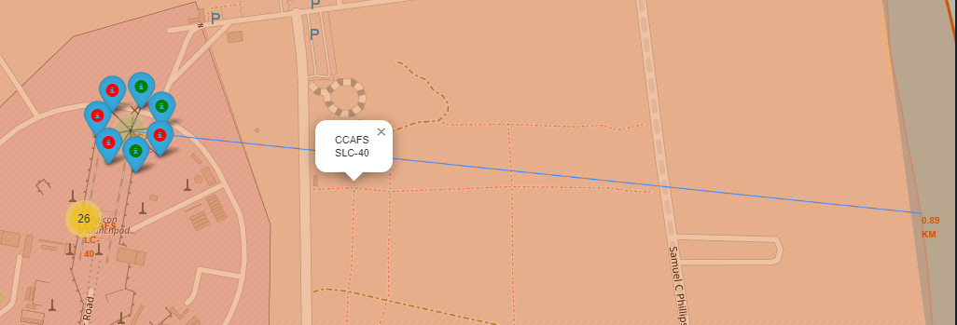
Distances between CCAFS SLC-40 and Proximities (Coast)
The map was updated to show the distance between a launch site and nearby proximities such as highways, railways and coast. The distance between CCAFS SLC-40 launch site and the coast was calculated using measurements taken from the map with MousePosition and a distance function. The proximities were labelled with the calculated distance and a line was drawn between the proximity and launch site.

Slide 46

Section 4

Slide 47
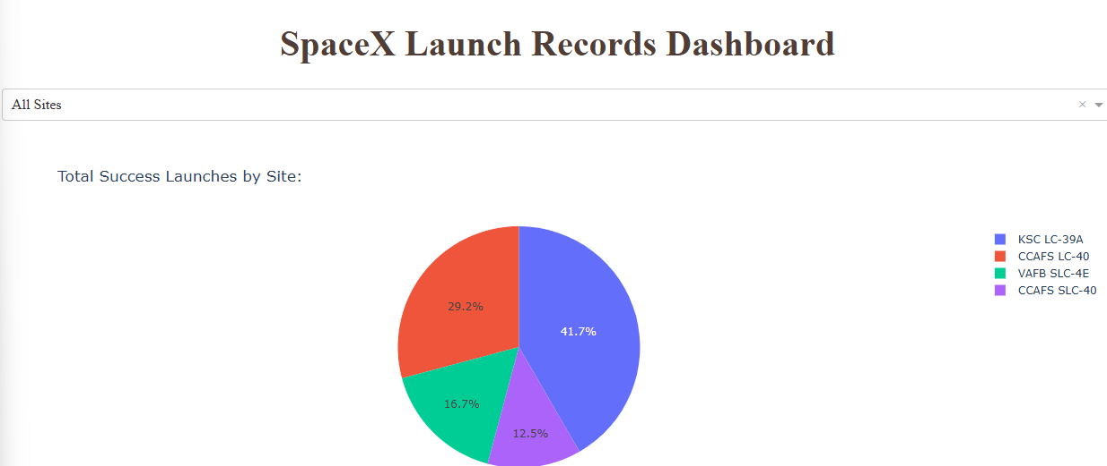
Launch Successes By Site Across All Sites.

Slide 48
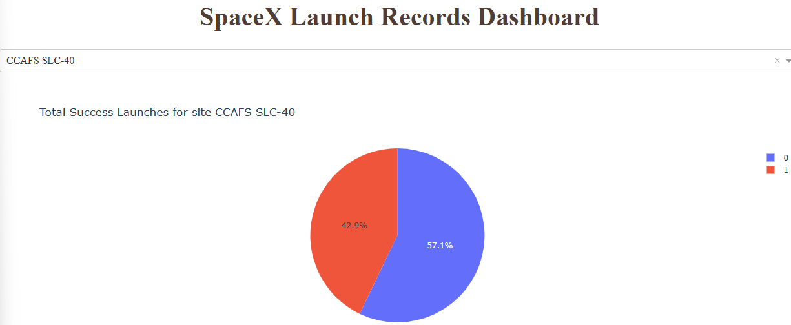
CCAFS SLC-40 Has the Highest Launch Success Ratio
The CCAFS SLC-40 site was found to have the highest success ratio with 42.9% successful launches. The pie chart shows success or failure by the colors shown in the legend. Percentages of percent and failures are shown in the pie chart. The dash board can show this breakdown for any of the four launch sites by selecting it in the dropdown.

Slide 49
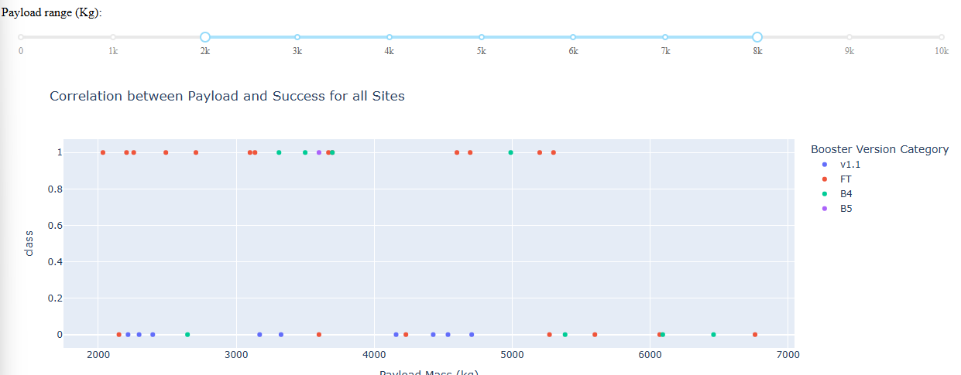
Payload vs Launch Scatter Plot for All Sites
This scatter plot shows the FT booster version has the best success across payloads from 2000 kg to 5500 kg. The v1.1 and B5 boosters have poor success and the B4 booster has mixed success across this payload range.

Slide 50

Section 5

Slide 51
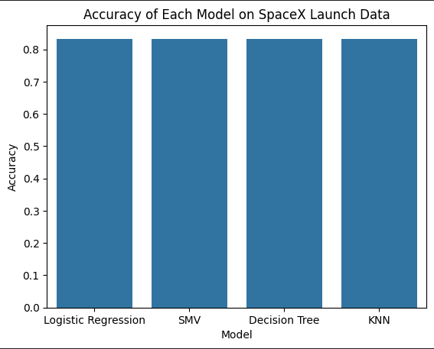
Classification Accuracy
Four models were developed and tested against the SpaceX launch data. For each model a Grid Search was performed to tune its hyperparamaters. After training and finding the optimal hyperparameters for each, the accuracy of each model was measured using the test data set. Each model produced an accuracy of 0.833. This was most likely due to the small data set used for modeling and evaluation.

Slide 52
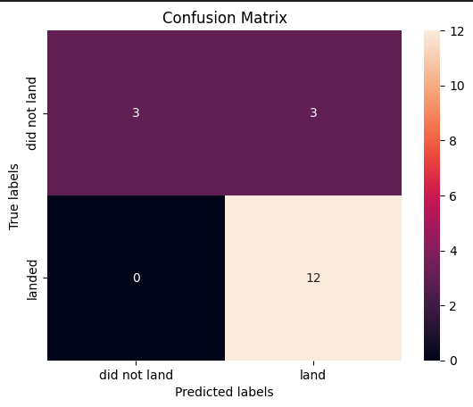
Confusion Matrix
As with accuracy, the confusion matrix for each model was found to be identical. The models predicted landed missions perfectly with 12 true positives and no false positives. Performances on unsuccessful missions was poor with 3 true negatives and 3 false negatives. As with accuracy this was probably due to too small a data set for training and testing.

Slide 53
Conclusions
SpaceX advertises its successful Falcon 9 launches are 62 million dollars while its competitors cost upward of 165 million dollars for the same service. SpaceX is able to offer these savings because it successfully can land and reuse the first stage of the Falcon 9 booster rocket from many of its launches. Data collection, wrangling, exploratory data analysis, geographic visualization, interactive dashboards and predictive analysis was performed and determined the following.
Payload vs Launch Site visualization showed that higher success rates were associated with heavier payloads. Additionally, the Vanderburg Space Force Base only had launches with payload under 10000 kg.
Certain orbit types were found to be correlated with successful missions. ES-L1, GEO, HEO and SSO has 100% success rates.
Flight number with success/failure status was plotted against orbit type. It was seen seen that for VLEO the rate of success seems dependent on flight number. The relationship between success and flight number for other orbit types such as GTO and VLEO is less clear.

Slide 54
Conclusions
Success as a function of Payload vs Orbit type was visualized. Successful landing for heavy payloads are more likely for Polar, LEO and ISS. For GTO, a correlation between payload and success cannot be seem as the data is mixed.
The success rate was seen to generally increase with year. Rates kept rising from 2013 to 2017. Slight dips are seen in 2018 and 2020, but the overall increasing rate is clear.
Total payloads brought to space by SpaceX during the period were 45596 kg.
The average payload for the F9 V1.1 booster was 2535 kg.
Successful drone ship landings were seen with 4 different F9 booster versions.
A total of 98 missions were con2010-06-04 and 2017-03-20ducted over the period.
It is seen that between 2010 and 2017 the successful landings are in the minority. The most common outcome was no attempt at landing.

Slide 55
Conclusions
The location of the launch sites and launch outcomes were plotted on a map of the United States to foster better understanding.
Proximity analysis was conducted. It was found that the launch sites were close to highways, railways and the coast.
Close railways and highways support transport of needed resources.
Close oceans are needed to support ocean landings as are sometimes conducted.
It was seen that the most successful launches occurred at KSC LC-39A site.
The CCAFS SLC-40 site was found to have the highest success ratio with 42.9% successful launches.
Analysis of payload vs success for various booster models showed the FT booster version has the best success across payloads from 2000 kg to 5500 kg. The v1.1 and B5 boosters have poor success and the B4 booster has mixed success across this payload range.

Slide 56
Conclusions
Four models, Logistic Regression, SMV, Binary Tree and KNN were developed.
A grid search method was used to find optimal hyperparameters for each.
The accuracies of each of the models were found to be equivalent and equal to 0.833.
The confusion matrix of each model was graphed. As with accuracy, the confusion matrix for each model was found to be identical. The models predicted landed missions perfectly with 12 true positives and no false positives. Performances on unsuccessful missions was poor with 3 true negatives and 3 false negatives.
The equal performance of all the models was probably due to the small size of the data set.

Slide 57
Appendix
All data, python and artifacts are located in GitHub at jrkopp/data-science-capstone and are available for reference.

Slide 58


